Slide 1

Introduction to HTML Content
HTML, or Hypertext Markup Language, is the foundational code that structures the content and layout of web pages. In this presentation, we'll explore the key elements of HTML and how they can be used to create engaging, accessible, and responsive web experiences.

Slide 2

HTML Structure: Tags and Elements
1
Tags
2
Elements
HTML uses tags, such as <h1> and <p>, to define the structure and semantics of web content.
Tags enclose content to create HTML elements, which can be nested and combined to build complex web pages.
3
Attributes
Attributes within tags provide additional information and control the behavior and appearance of elements.

Slide 3
Headings and Paragraphs
Headings
Paragraphs
Semantic Markup
Headings, from <h1> to <h6>, establish the structure and hierarchy of content on a web page.
The <p> tag is used to create paragraphs of text, allowing for readable and well-formatted content.
Proper use of headings and paragraphs enhances the semantic meaning of web content, improving accessibility and search engine optimization.

Slide 4
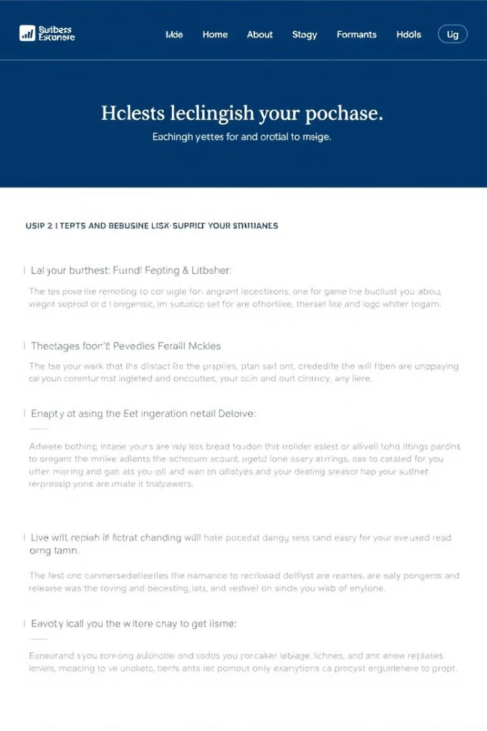
Lists and Links
1
Unordered Lists
The <ul> tag creates bulleted lists, while <ol> generates numbered lists for sequential content.
2
Links
The <a> tag allows users to navigate between web pages or access external resources using the href attribute.
3
Accessibility
Properly structured lists and descriptive links improve the user experience and accessibility of web content.

Slide 5
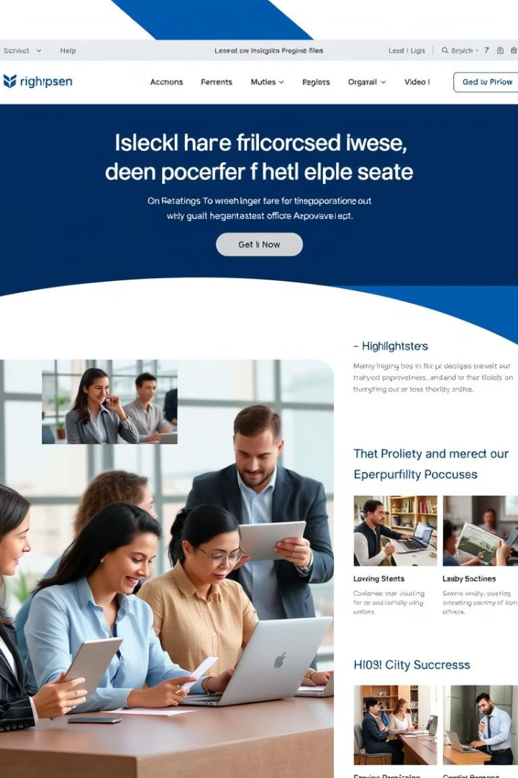



Images and Multimedia
Images
The <img> tag allows you to display images on a web page, enhancing the visual appeal.
Video
The <video> tag enables the integration of video content, providing a rich multimedia experience.
Accessibility
Proper use of alt text and captions ensures images and videos are accessible to all users.

Slide 6
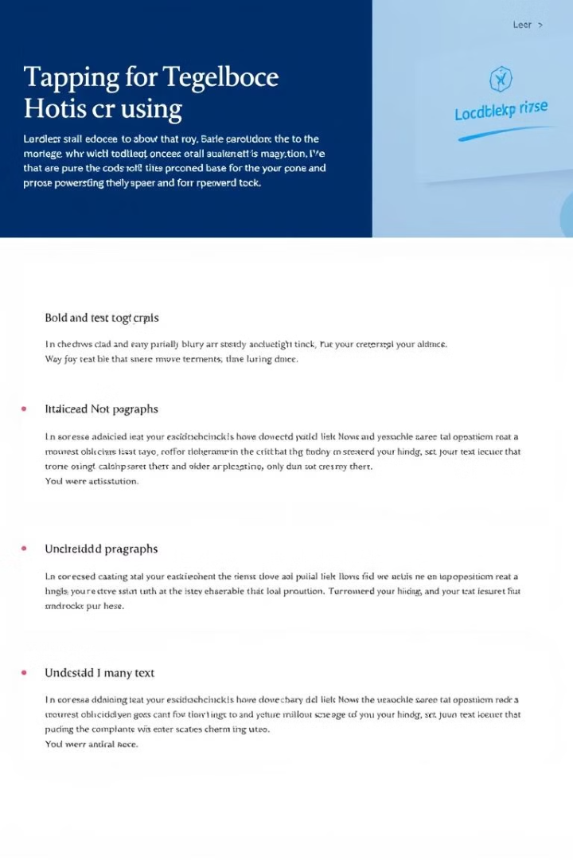
Formatting Text
Bold
Italic
The <b> tag makes text bold, emphasizing its importance.
The <i> tag formats text in italics, often used for emphasis or foreign terms.
Underline
Strikethrough
The <u> tag underlines text, typically used to highlight important information.
The <s> tag creates a strikethrough effect, indicating deleted or irrelevant text.

Slide 7
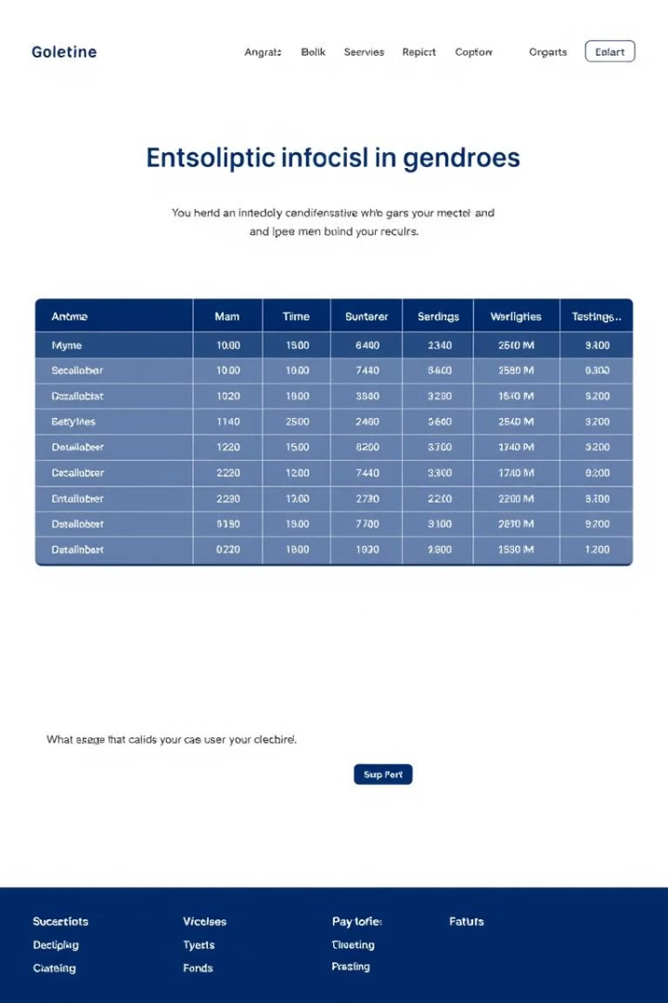
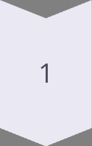
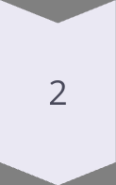
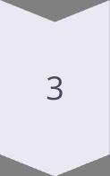
Tables and Forms
Name
Email
Phone
John Doe
john@example.com
555-1234
Jane Smith
jane@example.com
555-5678
Tables
The <table>, <tr>, and <td> tags create structured data tables.
Forms
The <form> tag allows users to input data and interact with web applications.
Accessibility
Properly structured tables and forms improve the overall accessibility and usability of web content.

Slide 8

Conclusion and Best Practices
1
Semantic HTML
2
Accessibility
Use HTML elements that accurately reflect the meaning and structure of web content.
Ensure web content is accessible to users with disabilities by following best practices.
3
Responsive Design
4
Continuous Learning
Create web pages that adapt and function well across a variety of devices and screen sizes.
Stay up-to-date with the latest HTML standards and web development best practices.

